Slide 1
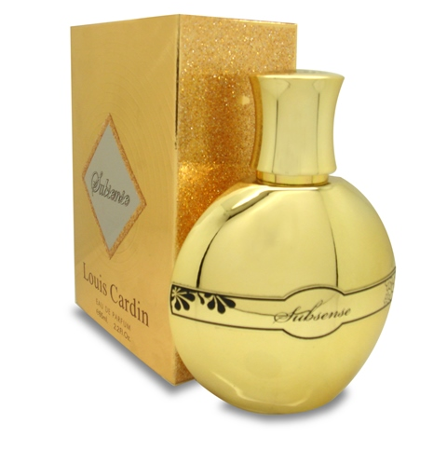
Louis Cardin
Brand Presentation
2016

Slide 5
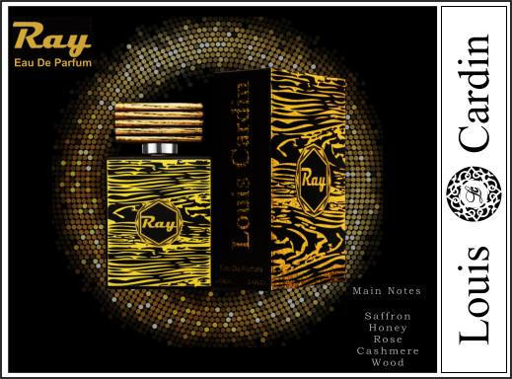

Slide 6
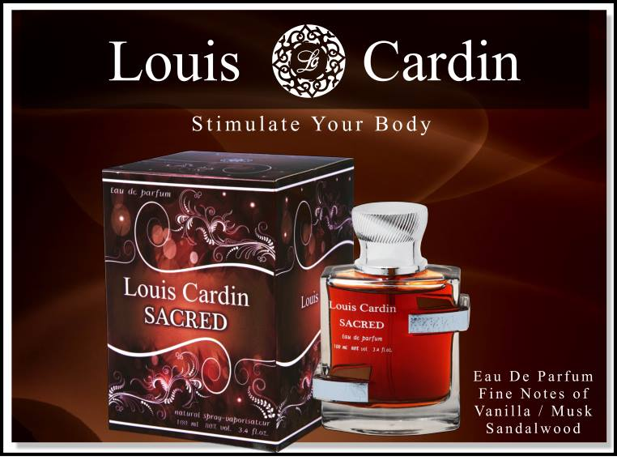

Slide 7
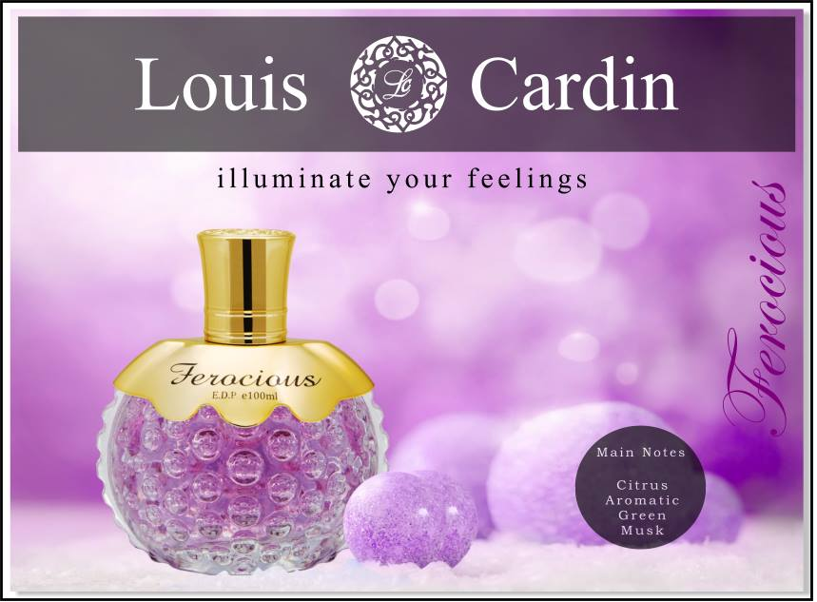

Slide 9
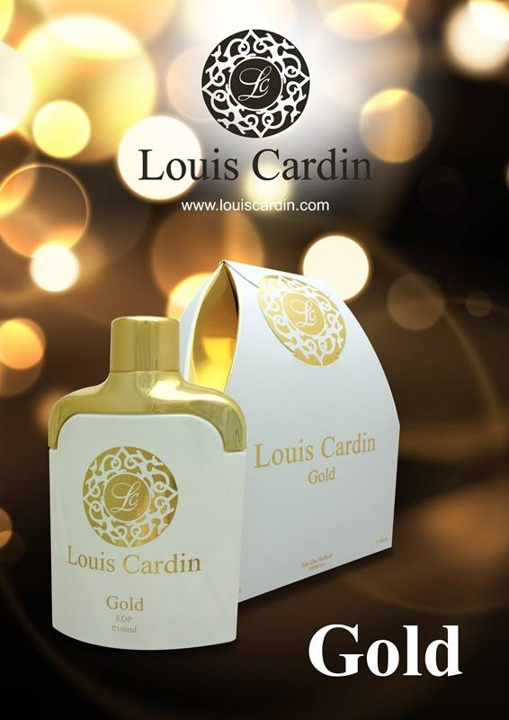
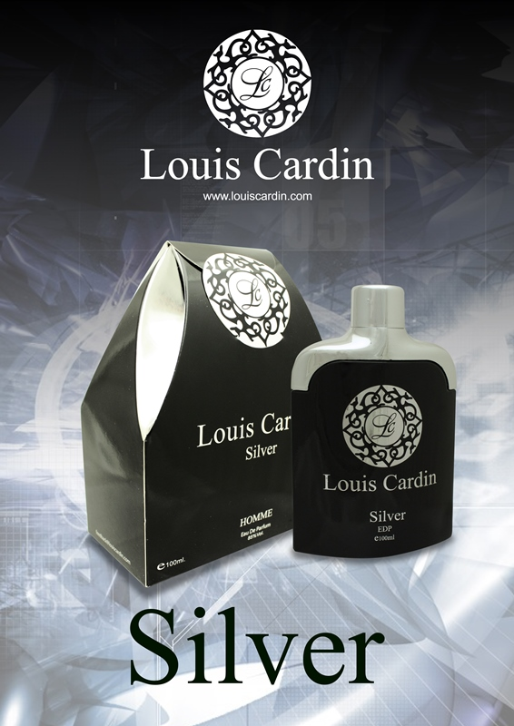

Slide 12
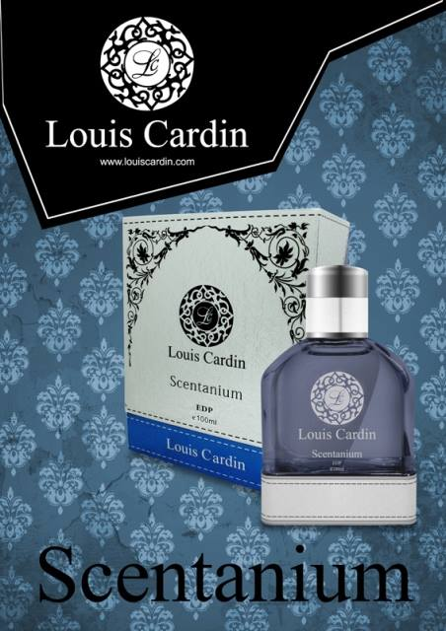
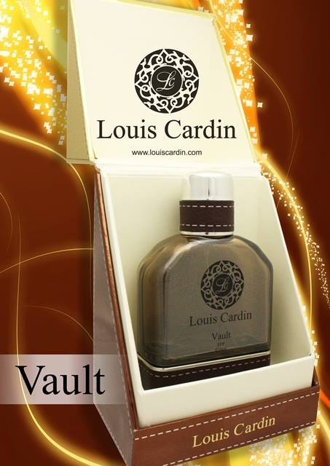

Slide 14
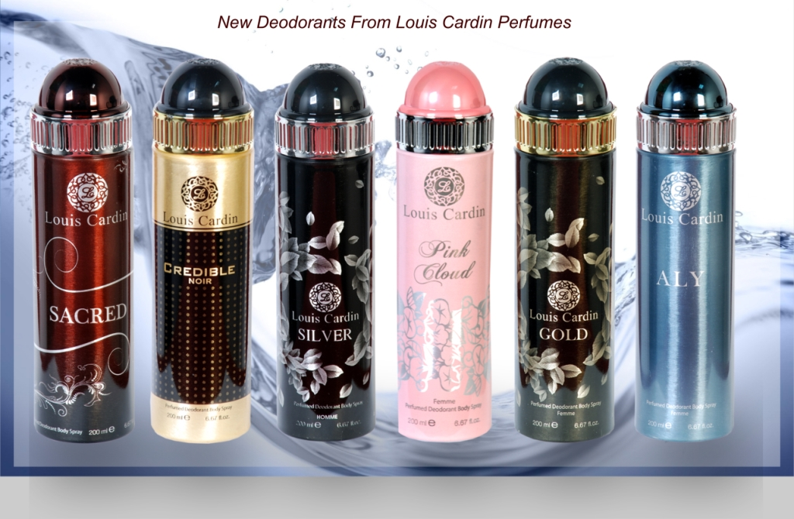

Slide 15
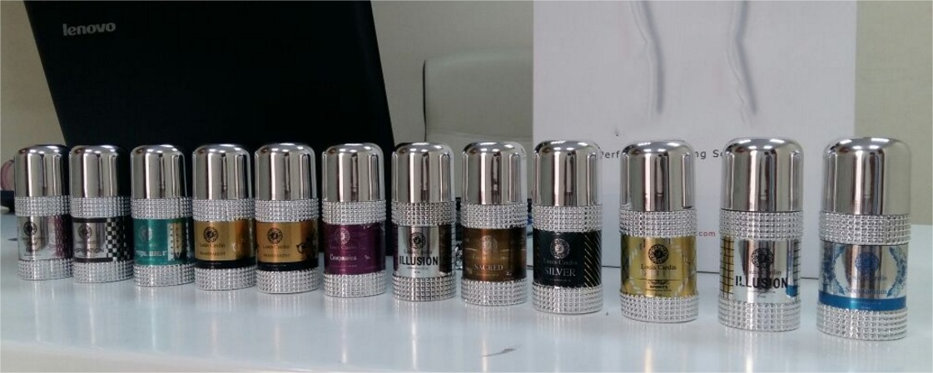

Slide 17
Louis Cardin
“In an environment of constant change and spiraling complexity, it is becoming increasingly apparent that the traditional operating model, if not broken, is no longer fit for purpose.”
- Anastasia Economos, Co-Global Household and Personal Care Leader, Ernst & Young LLP (US)

Slide 18
Personal Care Market Universe
Population
Gross National Income : US$
Currency 1 USD =
Capital :
Personal Category : Strong + Robust
Total Market Size is 2.50 Billion
Personal Care comes in 2nd Spot – After Food & Beverages
High Consumer Confidence Index – Age 25 to 60

Slide 19
Back Ground
Louis Cardin is headed by a professional with over 40 years of experience in watch designing
Louis Cardin as a brand name is synonyms with high quality & aggressive pricing.
It is with this expertise that created a spark in the designer’s mind which prompted him to offer to the valued consumers.
A quality, no less than the finest in the world with pricing that are affordable to a common man.

Slide 20
Brand Strategy
Launch Additional Variants in Eau De Parfum For Men
Increase Variants in Eau De Parfum for Women
Launch Talc/Powder by Feb 2016
Launch Roll-On Deo by Feb 2016
Launch Body Lotion by March 2016
Launch Face Cream by March 2016

Slide 21
Strength
Brand Performing Well in 25 Countries
Ability to Perform Well in Most Competitive Environments
Creative Fragrances
Long Lasting & Diffusive
Reasonably Priced
Quick Acceptance of the Brand
Blends well with Local & Floating Population

Slide 22
Product Range
Eau De Parfum For Men 100ml
Eau De Parfum For Women 100ml
Perfumed Deodorant Sprays 200ml
Deodorant Roll-On 50ml
Deodorant Talc 125gm / 250gm
Body Lotion 125ml / 250ml
Body Cream 60ml / 120 ml

Slide 23
Consumer Profiles
Masstige
Prestige factor rules !
Packaging Sense
Seek Premium Appeal
Superior Fragrance
Seeks Style
POS Treatment

Slide 24
Louis Cardin - The Brand
AMONG THE TOP THREE PERFUME BRANDS IN THE UAE
THE FASTEST GROWING BRAND IN THE UAE
CREATED A NEW NICHE IN THE PERFUME INDUSTRY
WILL BE AVAILABLE IN THE QATAR DUTY FREE IN THE NEXT COUPLE OF MONTHS
VIBRANT PACKING AND SUPERRIOR LONG LASTING FRAGRANCE
THE ONLY BRAND IN THE MASS MARKET WHERE 50 % OF SALES ARE FROM NORMAL PACKS

Slide 25
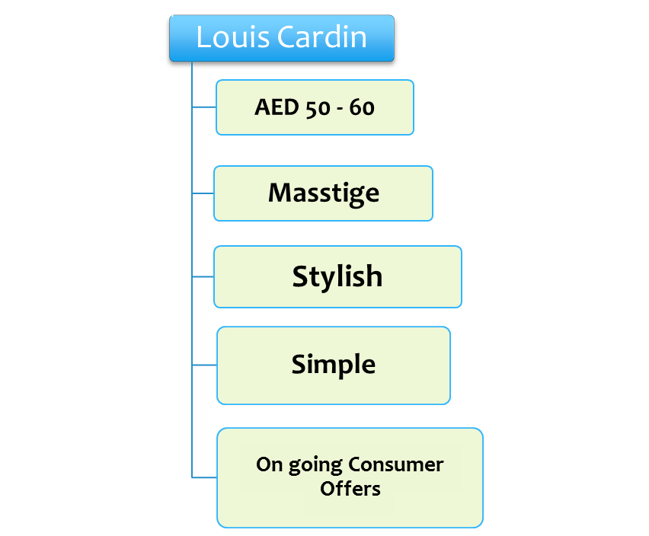
Perfumery - Brand Identities

Slide 26
Louis Cardin Identities

Slide 27
Current Market Scenario
Highly Overcrowded Category
Lack of Physical Space in Segment
Cost of Entry is Extremely High & Time Consuming
Competition Extremely Active
RSP US$ 15/- & above a good niche in current market positioning Catering to Consumers looking for high Quality Perfumes at Affordable Prices
Highly Promotion Driven Category For Mass Market Perfumes where there exists no brand loyalty whatsoever
Consumers looking for a better product in terms of Quality & Respectability are willing to pay a premium price

Slide 28
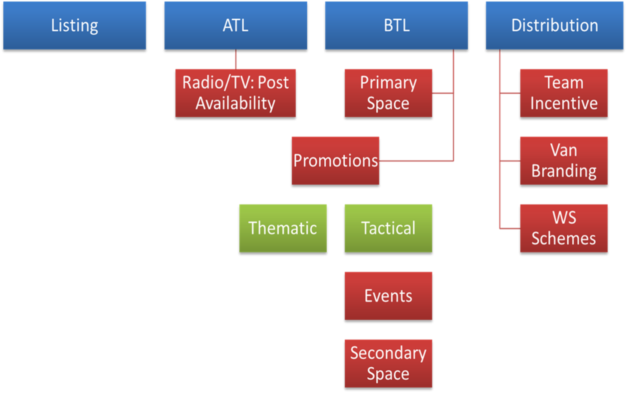
Market Activities / Investment Plans

Slide 29
Price Comparison
Louis Cardin 59.00 AED
Others 39 ~ 28.50 AED
1 USD = 3.67 AED

Slide 30
Brand Positioning

Slide 31
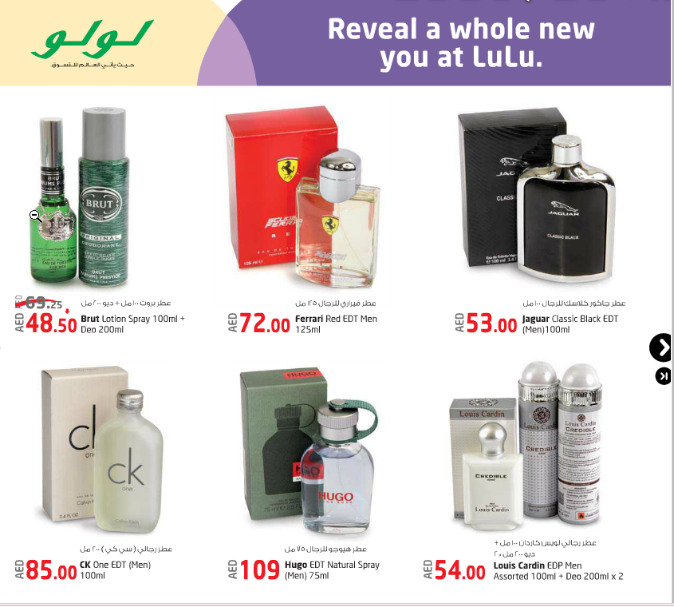
Brand Positioning

Slide 32
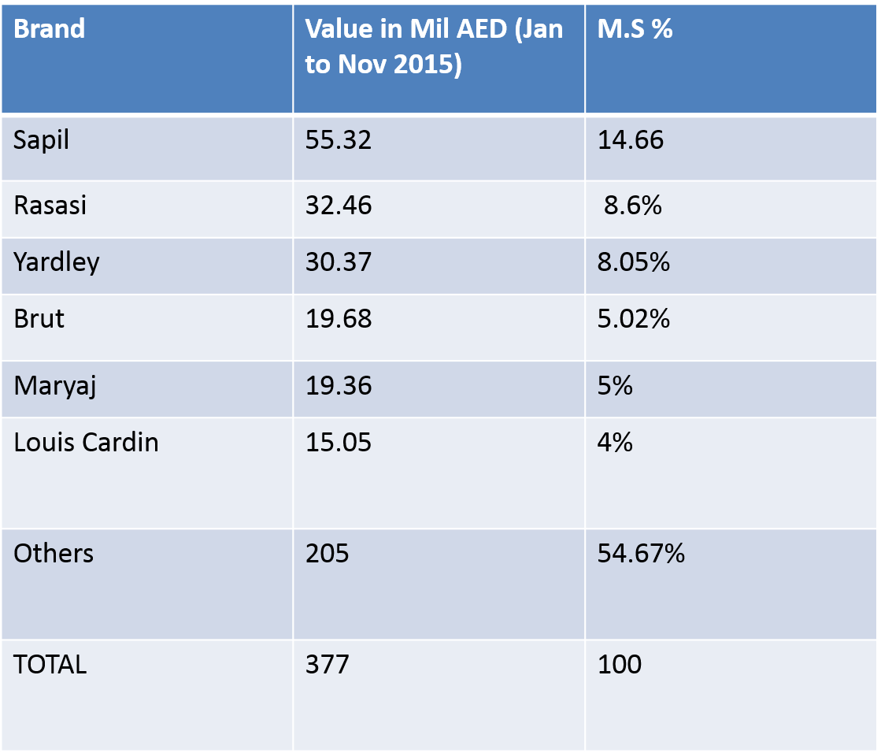
UAE Market share
40 year old
40 year old
200 year old
100 year old
40 year old
2 year old

Slide 33
Europe Quality Award

Slide 34
GMP Certification

Slide 35
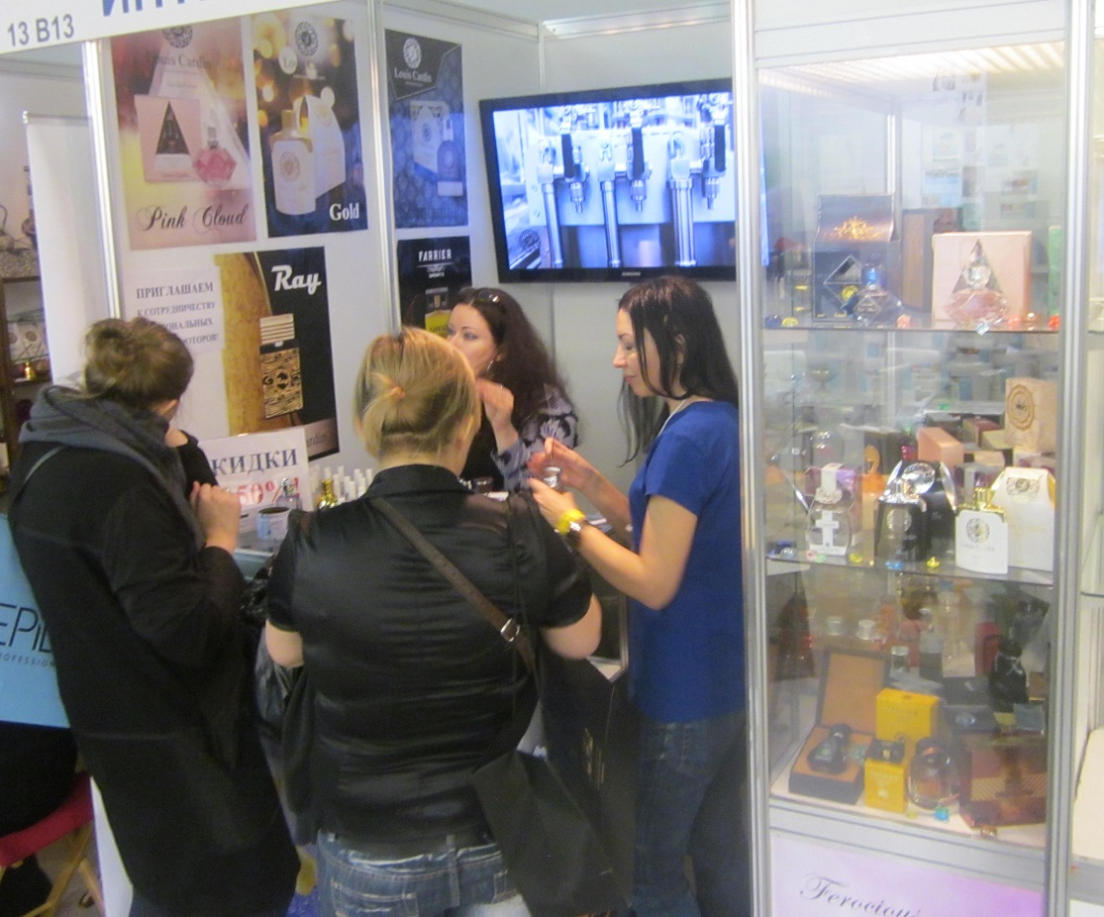
Louis Cardin Russia

Slide 36
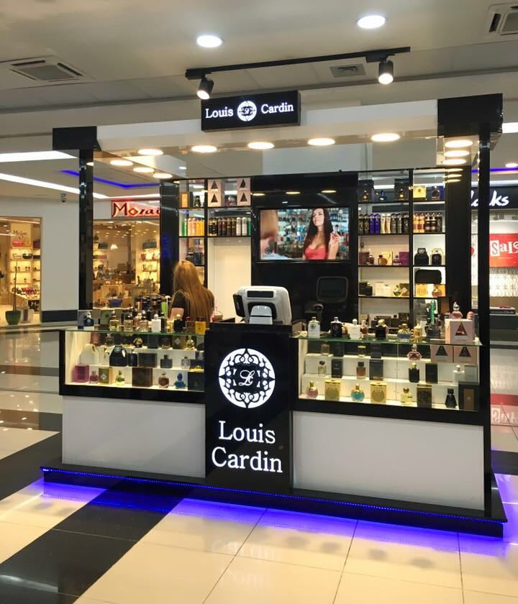
IRAQ

Slide 37
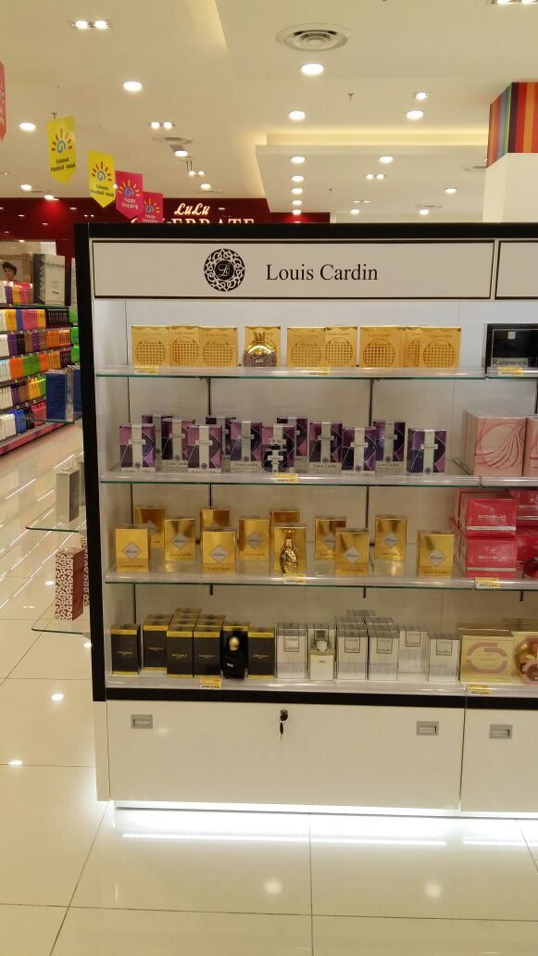
MALAYSIA

Slide 38
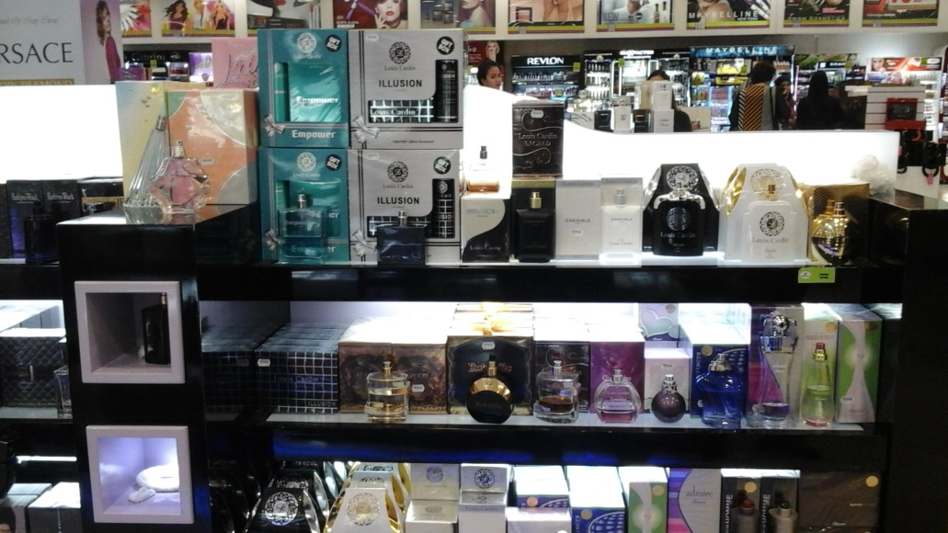
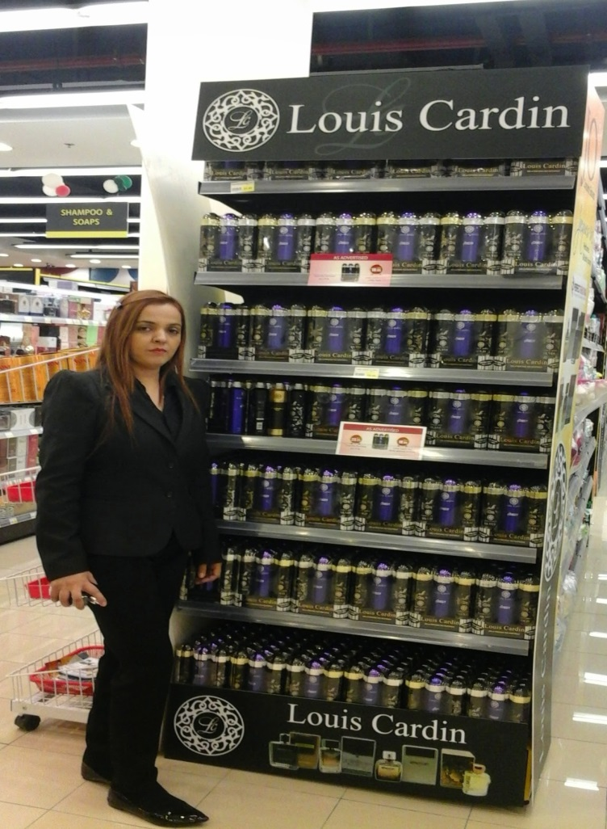
Retail Activations

Slide 39
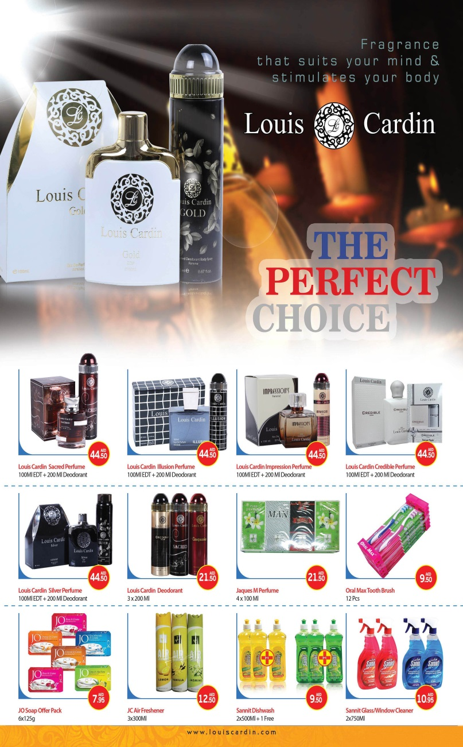
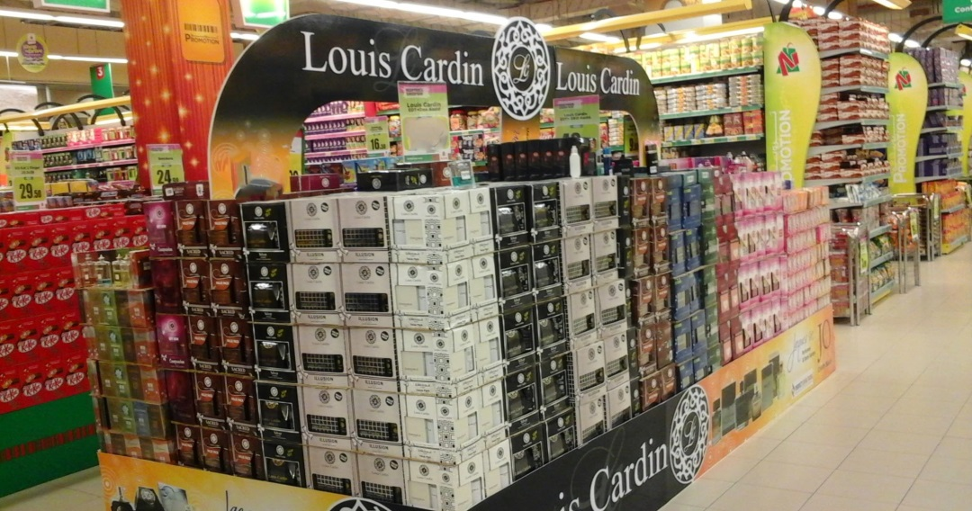
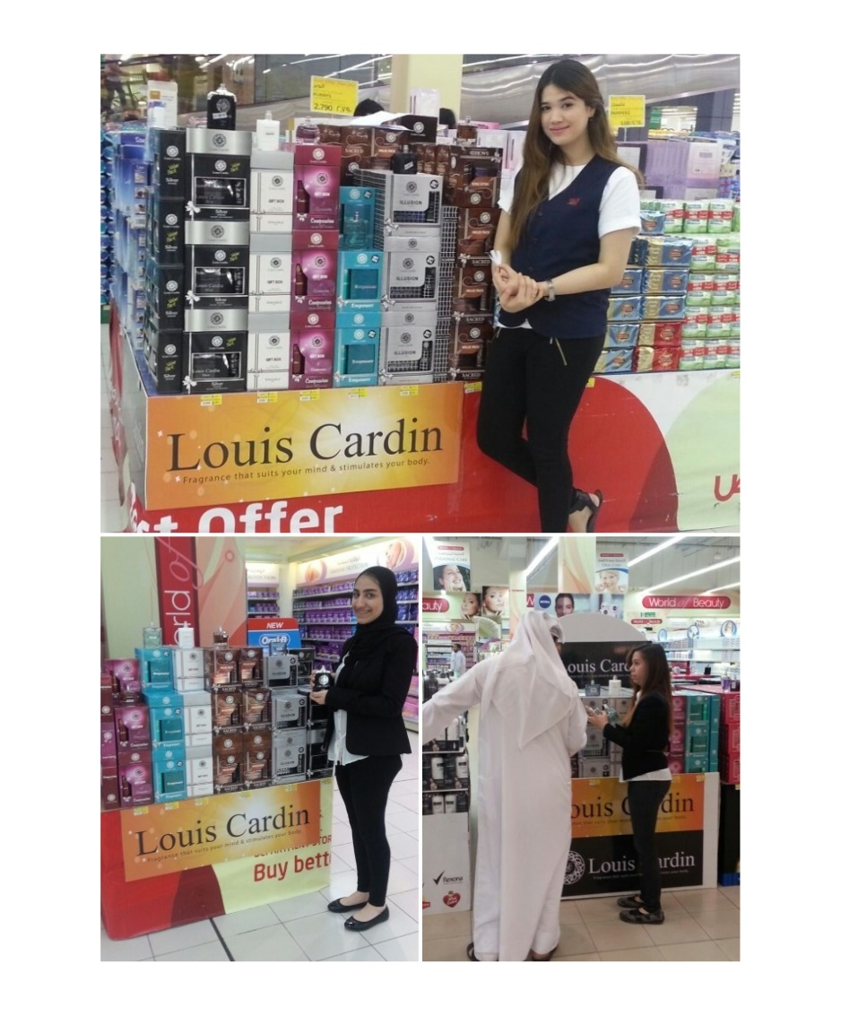

Slide 40
Shelf Talker

Slide 41
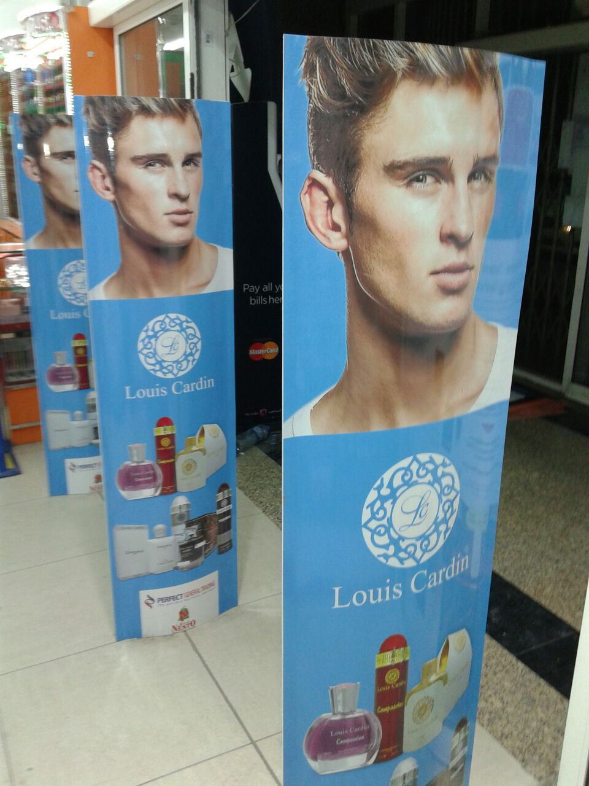
Counter Display

Slide 42
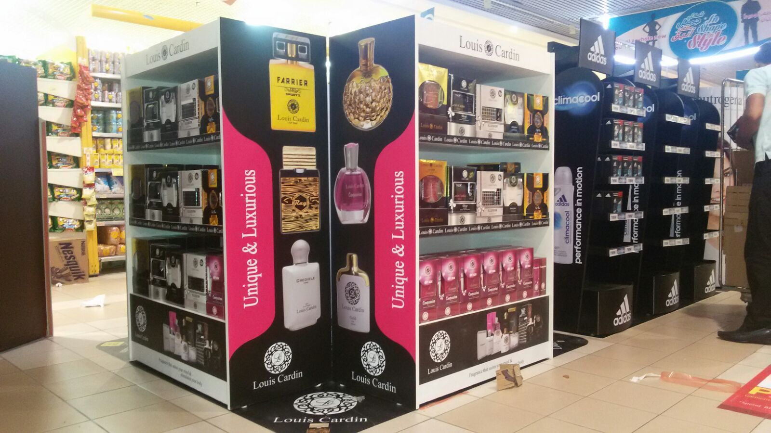
4 mtr Square Back To Back Floor Display

Slide 43
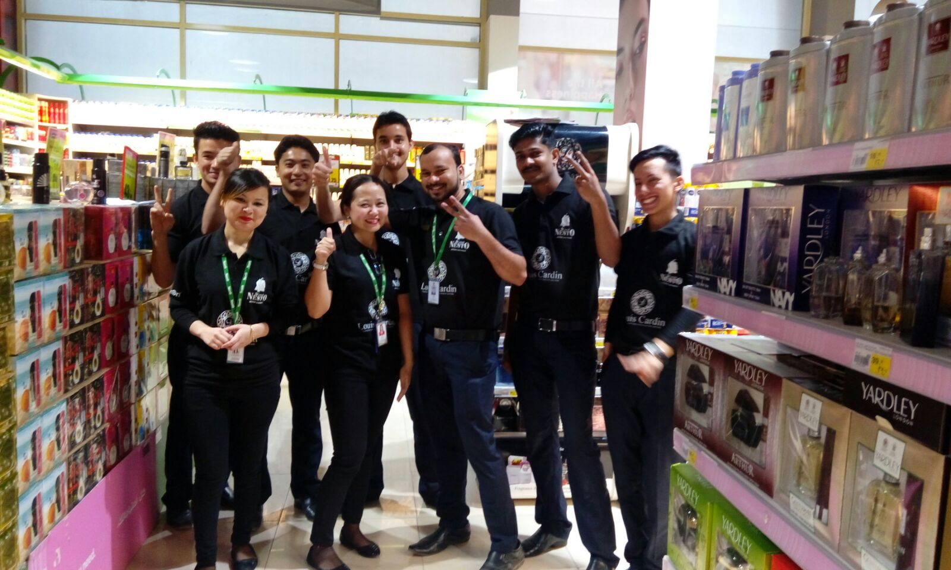
Retail Outlet Co-Branding

Slide 44
VAN Branding

Slide 45
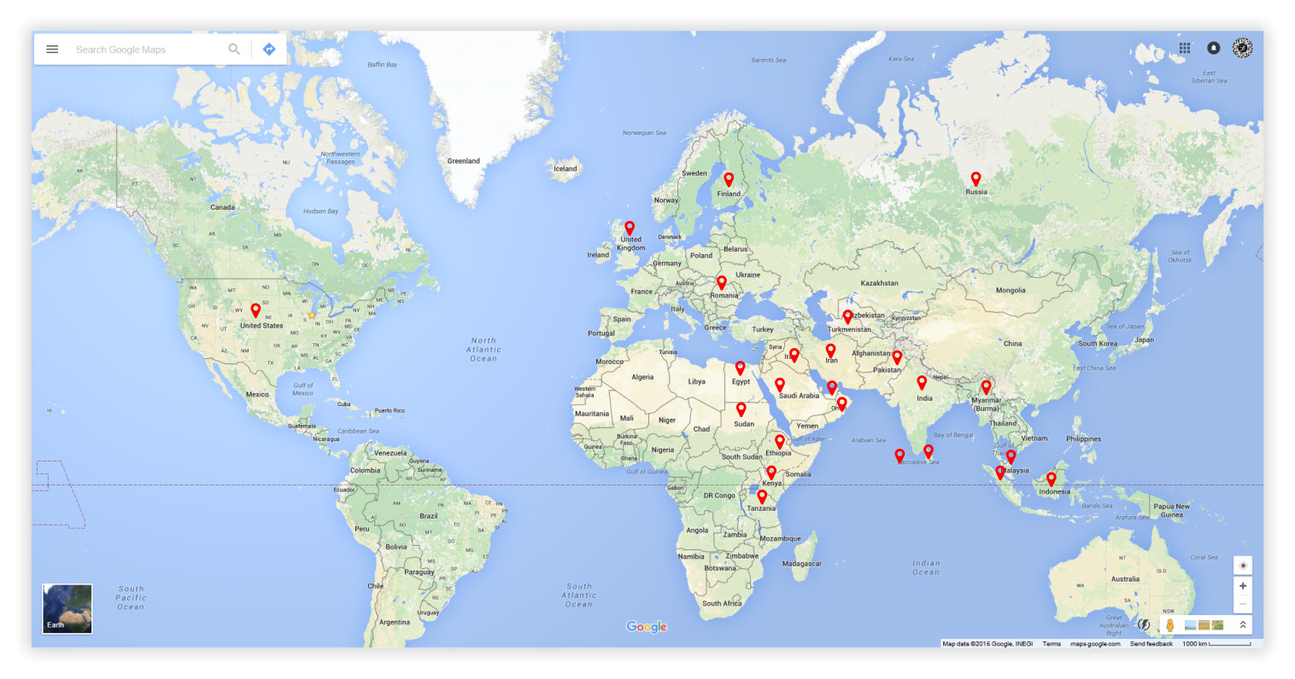
International Availability

Slide 46
International Availability
Bahrain | Nigeria
Czeck Republic | Oman
Djibouti | Pakistan
Egypt | Palestine
Ethiopia | Qatar
Finland | Romania
Ghana | Russia
India | Saudi Arabia
Indonesia | Singapore
Iraq | Sri Lanka
Jordan | Sudan
Kenya | Tanzania
Kuwait | Turkmenistan
Malaysia | Uganda
Maldives | United Arab Emirates
Moldova | United Kingdom
Myanmar | United States Of America

Slide 47
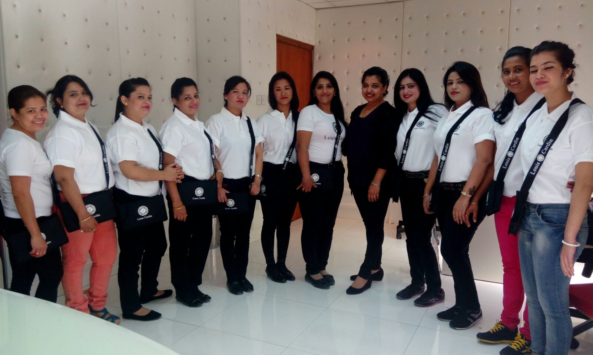
In Store Promoters Training

Slide 48
Louis Cardin
Thank you !
Louis Cardin Watches & Perfumes – Dubai – United Arab Emirates
Louis Cardin Perfumes USA LLC – Chicago – United States of America

